Slide 1
“Hello Class!”
Getting started programming in Java

Slide 2
What we’ll be covering
Making sure we’re all ready to start programming
Canvas account
Joined class
Github account
Java (JDK + JRE)
Eclipse
What’s an int?
int, char
What’s a String?
“Printing” output
Getting input

Slide 3
We spent the first class we installed the two components of Java
The JRE (Java Runtime Environment)
The JDK (Java Development Kit)
We also installed Eclipse
This will be our go to program for writing, running and fixing our Java code
Eclipse and Java

Slide 4
How programming works
Write commands in a text file that the computer can understand
“Syntax”
You have to write in a very specific way....
Capitals matter
Certain characters or words are special
“Run” a program to make the computer run through your steps

Slide 5

Starting a new Project
Put on your hoodie, we’re about to get programming
Open up Eclipse
Select your workspace
Set as default
File -> Project > New > Java Project

Slide 6
The Source
You’ll now see on the left-side of your screen a folder with the name of your project
If you open that up, there is another called “src”
This is the folder where you’ll be typing your “source code”
Remember, “source code” is really just instructions for your computer to follow
Create a new class
This is really just a file containing some instructions
File > New > Class
Usually the name of a class starts with a capital letter
I’ll call mine “Hello”
We’ll let Eclipse do some of the work for us, select “public static void main(String[] args)”

Slide 7
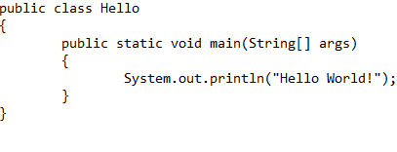
Saying Hello! ✋
Between the braces ( “{“ and “}” ), write...
System.out.println(“Hello World!”);
Be sure to type this exactly and don’t copy and paste

Slide 8
Running your Code
Congratulations, you’ve written your first Java program! Now we just have to make it run…
Run > Run > Java Application
Now look at the bottom of your screen (the “console”)
Now you’re a real Java programmer 👌👍😀

Slide 9
Make it personal 📌
public class Hello {
public static void main(String[] args){
//This is a comment!
System.out.println(“Hello I’m Ryan”);
}
}
Change the string between the quotation marks ( “” ) to greet the computer
You can add lines of text to the code, while telling the computer to ignore them
// This is a line comment
/* This is a multi-line comment
It can be used to “comment out” code
*/

Slide 10

Try This on For Size 👕
Try printing this: “Hello World! My Name is Andrew!”
Now try this... “Hello World! “ + “My Name is Andrew!”
Do you see any difference?
System.out.println(“Hello World! My name is Andrew”);
System.out.println(“Hello World!” + “My name is Andrew”);
Hello World! My name is Andrew
Hello World! My name is Andrew

Slide 11

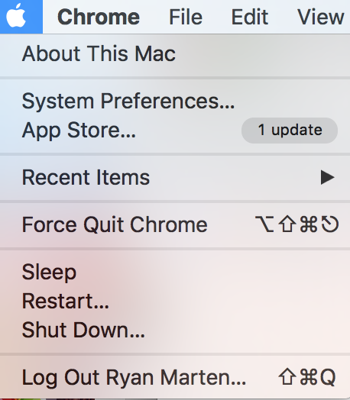
Concatenation
You can add two strings together with a “+” plus sign
Example: Personalized computer programs

Slide 12

A Little More Personal...
What if we want the computer to greet the person at the computer, but they didn’t write the code?
Programmers can use input for the program
While the program is running ( “run-time” ) the user can interact with the program
Example: Keyboard input for computer games

Slide 13

Checking it out 📕
import java.util.Scanner;
We can get input using a library
A library is a collection of pre-written files that we can reference in our own code.
The import command tells the compiler what libraries it needs to use
Always first thing in a file
At the top of your code, write in import java.util.Scanner;

Slide 14
Taking Names 💪
Scanner scanner = new Scanner(System.in);
System.out.println(“Hi, “ + scanner.nextLine());
scanner.close();
Okay, soo what did that do?
On it’s own, that did nothing
Now we’re going to make a Scanner and use it to take the name of whoever is running the program
Since we don’t need our Scanner anymore, we can close out of it
> Andrew
Hi, Andrew

Slide 15
The Final Stretch 🏁
Create a new class file and make a program that will.
Print out your favorite food
Print out your favorite number
Ask a question to the user
Respond using the answer to that question
I like pizza
42 is a great number
What’s your favorite number?
> 43
I think 42 is better than 43

